Slide 1
Emotion Detection From Tweets And Emoticons
Made by-
Jain Rajat Ashok(22)
Dubey Arun Kumar Vyas (14)
Kshatriya Sawan Ranjan(32)
Shukla Pratyush Suresh(58)

Slide 2
Why Twitter Sentiment Analysis?
  Micro blogging sites have millions of people sharing their thoughts daily because of its characteristic short and simple manner of expression. We propose and investigate a paradigm to mine the sentiment from a popular real-time micro blogging service, Twitter, where users post real time reactions to and opinions about “everything”.
  Social networking sites like twitter, Facebook, etc. are the great source of communication for internet users. So these become an important source for understanding the opinions, views or emotions of people.
  We extract data, i.e. tweets from Twitter in real time and apply machine learning techniques to convert them into a useful form and then use it for building sentiment classifier. Given a piece of written text, the problem is to categorize the text into one specific sentiment polarity i.e. positive, negative or neutral.

Slide 3
Problem Statement
• Text Level Analysis:
Given a message, we decide whether the message is of positive negative or neutral sentiment.
For messages conveying both a positive, negative sentiment, whichever is the stronger sentiment should be chosen.
•Emojis Level Analysis :
Given a Emoji whether that instance is positive, negative in that context.

Slide 4
Objective
Using algorithm to classify text and emoticons into positive, negative.
Sentiment analysis extracts information from the opinions and emotions of people in regards to entities, events and their attributes.
The learning algorithm will then learn what our emotions are from statistical data and then determine the emotion.

Slide 5

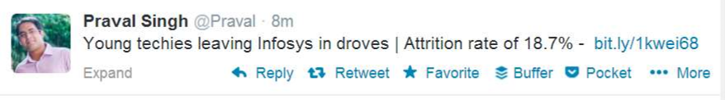

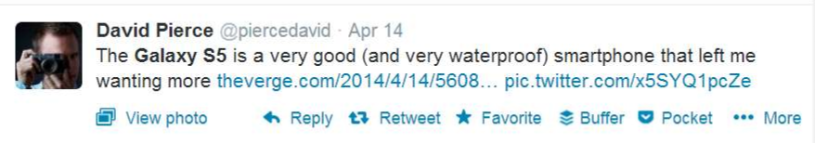
Example:

Slide 6
Scope :
The amount of relevant data is much larger for twitter, as compared to traditional blogging sites.
Moreover, the response on twitter is more prompt and also more general
This could be done by analyzing overall public sentiment towards that firm with respect to time and using economics tools for finding the public sentiment.
Firms can also estimate how well their product is responding in the market, which areas of the market is it having a favorable response and in which a negative response.

Slide 7
Motivation :
Sentimental analysis is a hot topic of research.
Use of electronic media is increasing day by day.
It can lead to more accurate tools for extracting semantic information.
It provide means for empirically studying properties of social interaction.

Slide 8
Literature Review :
Year | Tittle | Author | Methods/Algorithm used | Publication
2016 | Text Sentiment Analysis Based on Long Short-Term Memory | Dan Li, Jiang Qian | Recurrent Neural Network Long Short-Term Memory (RNN-LSTM) | IEEE
2018 | Sentiment Analysis with Long Short-Term Memory networks | Fenna Miedema | Long Short-Term Memory (LSTM) | IEEE
2013 | Sentiment Analysis in Twitter using Machine Learning Techniques | Neethu M S, Rajasree R | Naive Bayes (NB), Maximum Entropy (ME), and Support Vector Machines (SVM) | IEEE

Slide 9
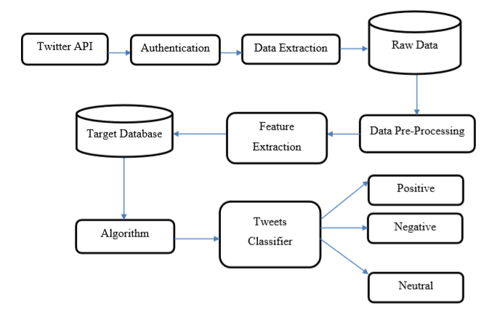
PROPOSED SYSTEM

Slide 10
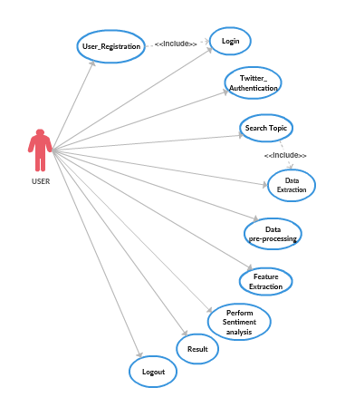
Use case:

Slide 11
Methods and Algorithm
A Recurrent Neural Network (RNN) is a class of artificial neural network where connections between nodes form a directed graph along a sequence.
Unlike feed forward neural networks , RNNs can use their internal state (memory) to process sequences of inputs. This makes them applicable to tasks such as handwriting recognition or speech recognition.

Slide 12
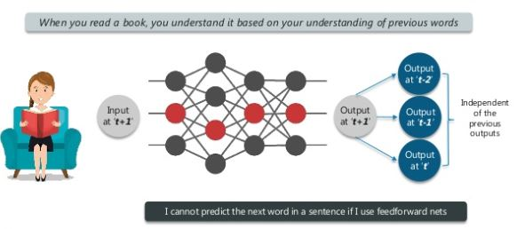
Why not Feed forward NN? Why RNN?

Slide 13
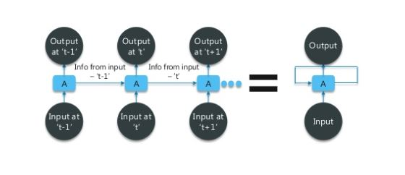
How to overcome this problem?

Slide 14
RNN
Recurrent neural network is a type of ANN designed to recognize patterns in sequence of data such as text, handwriting, spoken word, data emerging from sensors, stock market and many more.
But there are limitation
Sometimes it can be difficult to train standard RNNs to solve problems that require learning long-term dependencies.

Slide 15
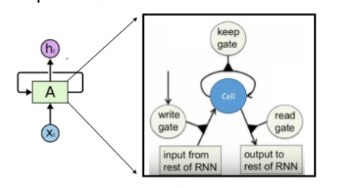
LSTMs(Long Short Term Memory) networks are a special kind of RNN, capable of learning long-term dependencies using LSTM units called a 'memory cell'. These cells can maintain information in memory for long periods of time.
LSTMs are a type of network that has a memory that "remembers" previous data from the input and makes decisions based on that knowledge.
Lstm Is used in products like
Google Translate
Apple Siri
Amazon Alexa

Slide 16
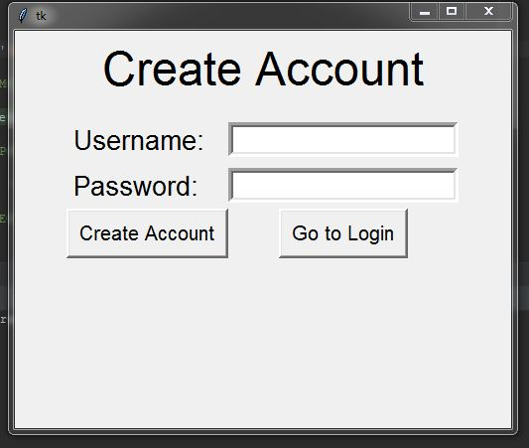
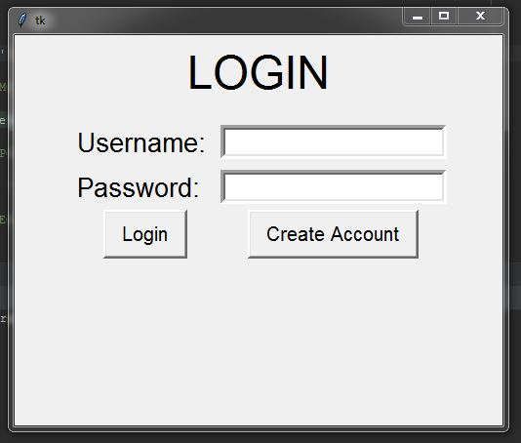
Implementation and Results

Slide 17
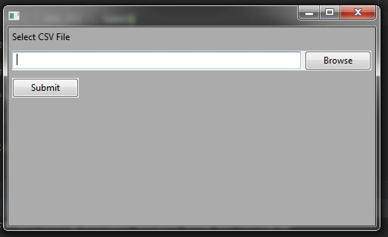
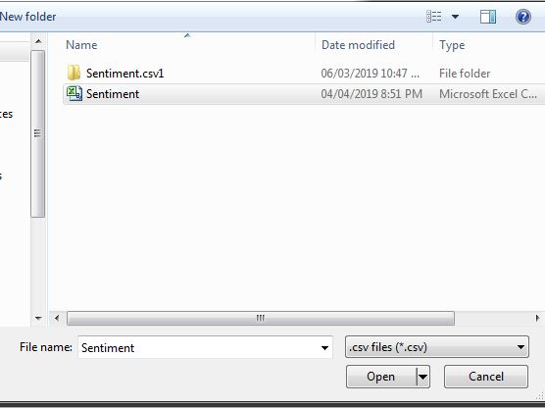

Slide 18
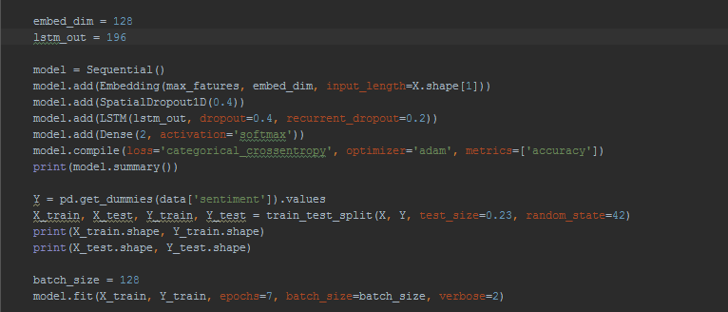

Slide 19
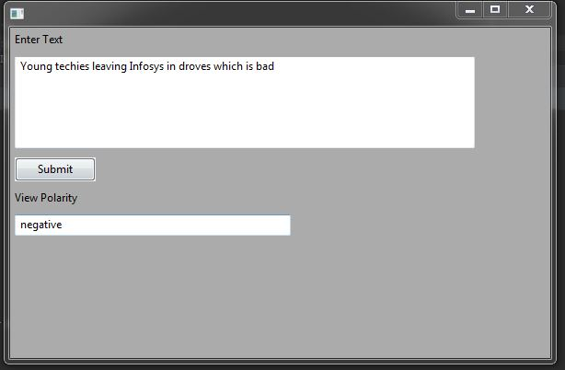

Slide 20
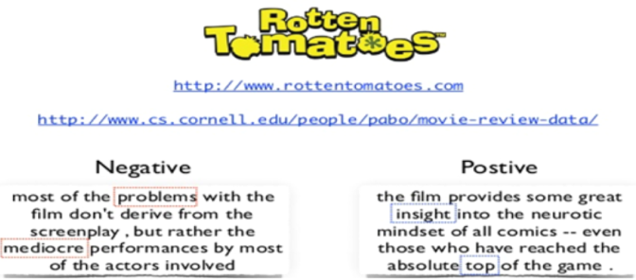
Applications
Used in Movie reviews

Slide 21
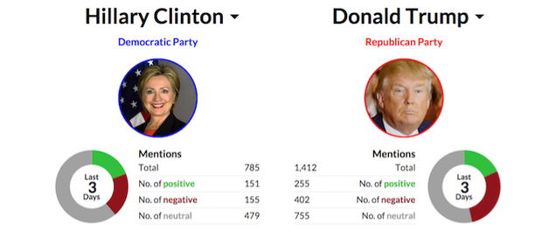
Knowing public opinion for political leader or their notions about rules and regulations

Slide 22
Future Work
Using different other models and algorithms.
Temporal analysis can be added as a future work in the project.
Consideration of Retweets as a factor.

Slide 23


